Slide 1
Bayesian Meta-Analysis-I
(Hierarchical Models)
Fish 558; Day 5: 08h30-10h00

Slide 2
Example Problem
A species is susceptible to a particular disease. We are interested in the incidence of the disease in our marine park. We sample 14 animals and find that 4 have the disease. It is known that similar experiments have been conducted in 70 other marine parks around the world.
What can be said about the incidence of the disease (and its uncertainty) in our marine park?

Slide 3
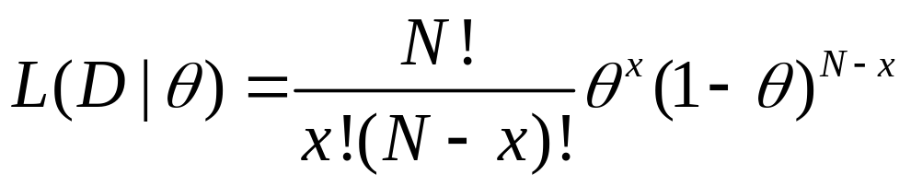
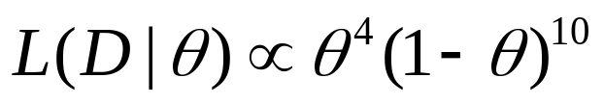
What do We know
The likelihood function for the data:

Slide 4
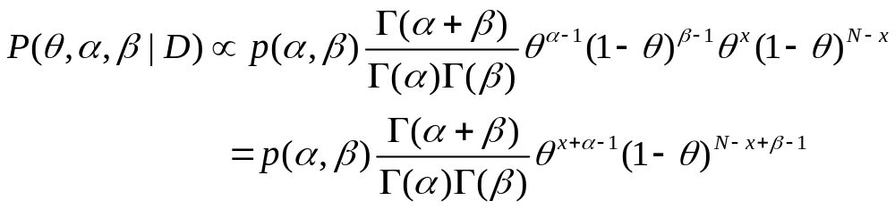
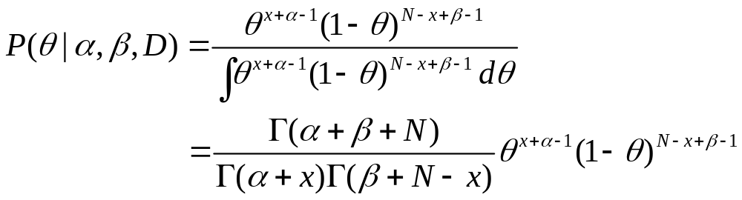
A Naïve Approach-I
We adopt a Bayesian approach. The prior for θ is Beta(α, β), i.e.
Prior
Likelihood

Slide 5
A Naïve Approach-II
The posterior for θ depends the values assigned to α and β.
  “Non-informative” (α=0.5, β=0.5; α=0, β=0).
  We can examine the sensitivity of the posterior to the (assumed) values for α and β.

Slide 6
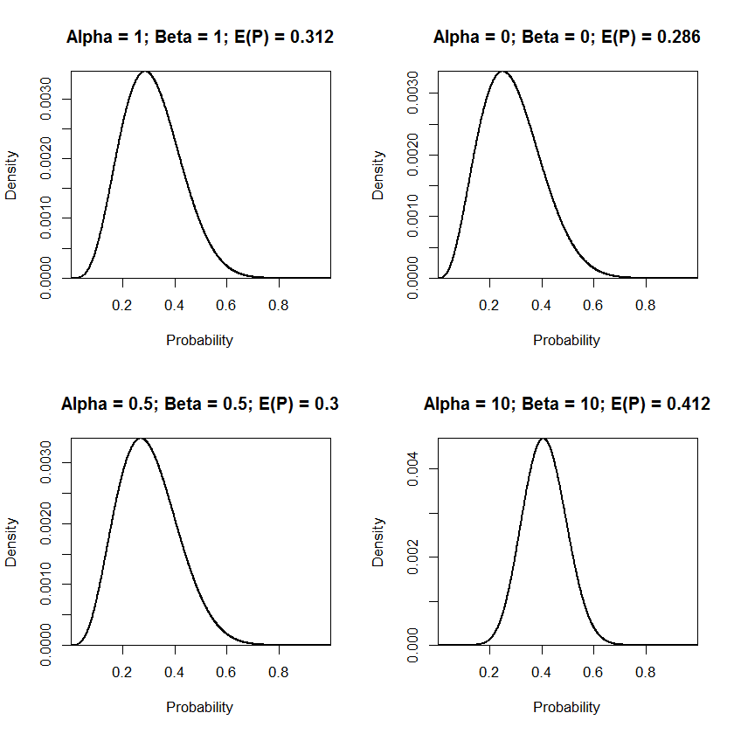
A Naïve Approach-III
The posterior mean is
equal to the ML estimate
only for α=0;β=0;

Slide 7
Why is this Approach Naïve?
The results depend on the value for α and β
We are not integrating across a prior for α and β, and hence not accounting for variability in these values
No account is taken of the data for the other marine parks.

Slide 8
Definition of fisheries meta-analysis
Summarize multiple (>5) studies/species that are treated as replicates of a shared process
Explicitly use a statistical model
Incorporate confidence/information from each constituent study

Slide 9
Types of variability among studies
Experimental
  e.g., Sampling
Parametric
  e.g., random variability in parameters
Functional
  e.g., differences in dynamics necessitating different parametric assumptions

Slide 10
Types of meta-analysis
There are various ways to conduct a meta-analysis:
  fitting models to data from multiple studies assuming a fixed-effects model.
  fitting models to data from multiple studies assuming a mixed-effects model.
  using Bayesian hierarchical techniques.
Not meta-analyses (according to Thorson et al. In press):
  vote counting;
  frequencies of parameter estimates;

Slide 11
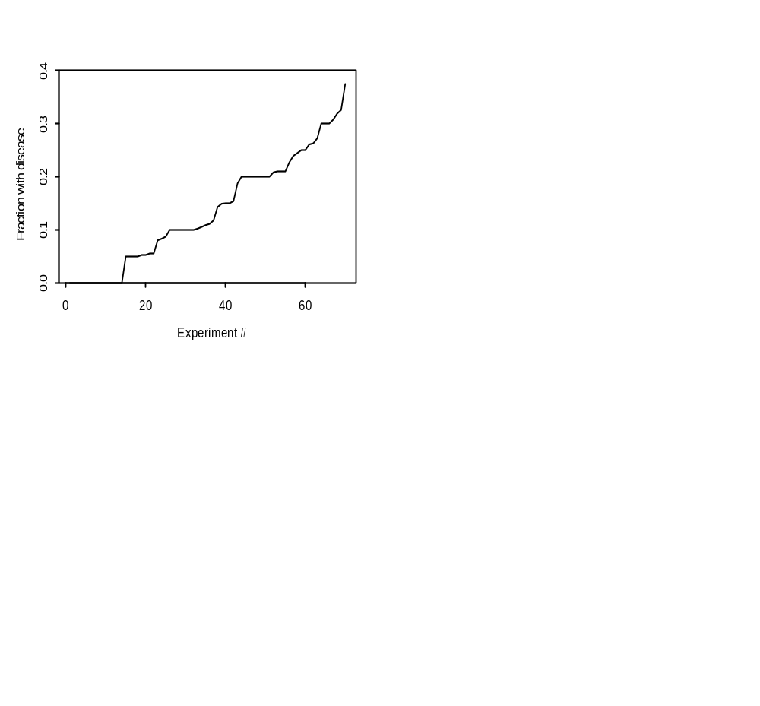


A less Naïve Version-I
We can summarize the existing experiments in terms of the inter-study mean and variance of the probability of the disease, i.e.:
The equates to:
Our study appear somewhat
“unlikely” given the existing studies.

Slide 12
A less Naïve Version-II
What happens if we plug in these estimates for α and β?

Slide 13
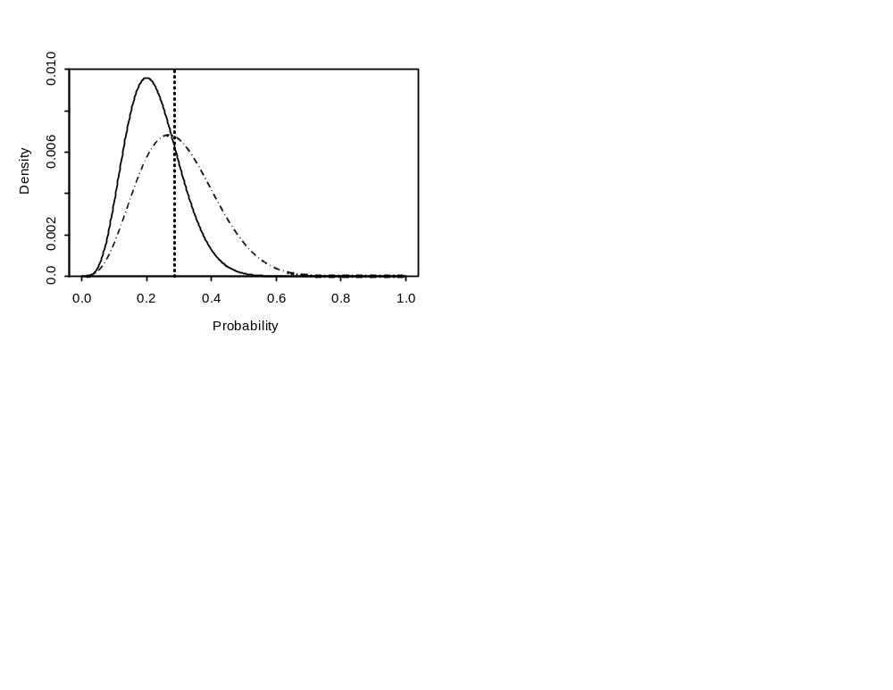
A less Naïve Version-II
The posterior mean is
lower than before. We
are still not accounting
for uncertainty in α / β.

Slide 14
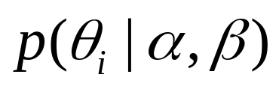

Further Assumptions
Assume that θ for each experiment is drawn randomly from an underlying distribution, i.e.:
where is the probability of having the disease in marine park i.
Note that we are not assuming that θ is the same in each marine park.

Slide 15









Structure of a Hierarchical model-I
….
….
….
….
….
….

Slide 16


Structure of a Hierarchical model-II
….
….
….
….
….
….

Slide 17
Structure of a Hierarchical model-III
Hyper-prior: p(α,β)
Prior: p(θ_{i}|α,β)
Covariates?
Likelihood: L(D|θ_{i})

Slide 18
Structure of a Hierarchical model-IV
A Bayesian hierarchical meta-analysis provides posterior distributions for:
  the values for the parameters of the prior (α and β in this example);
  the values for the parameters of the model (θ_{i} in this example);
  the value for the parameter θ for an “unknown” marine park; and
  the data that would be collected from an “unknown” marine park [this could form the basis for validation of the model].

Slide 19
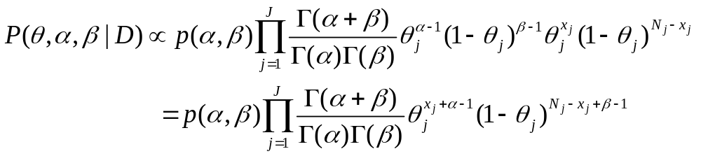
Structure of a Hierarchical model-V
We extend the previous formulation:

Slide 20
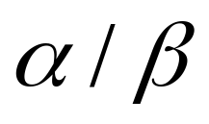
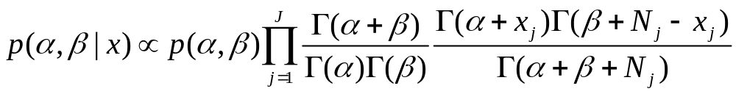
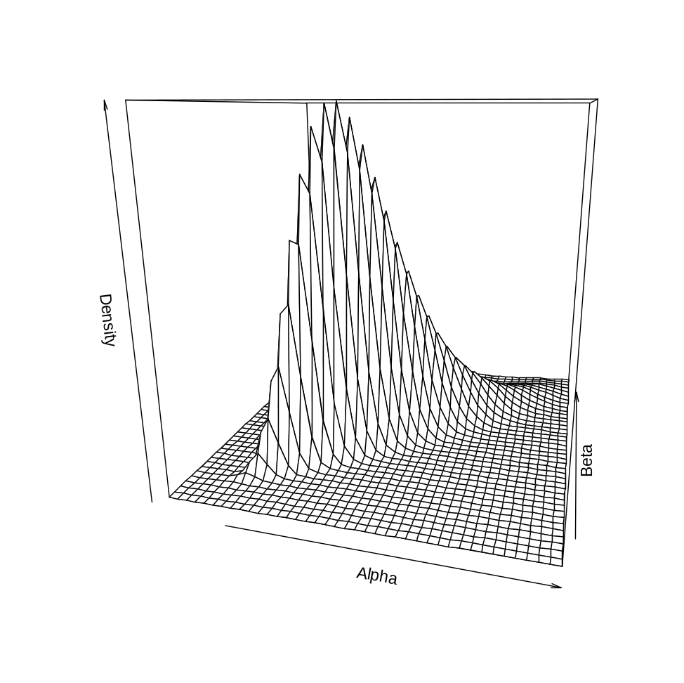
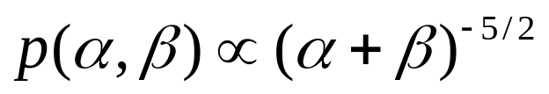
The Marginal Posterior for
The hyper-prior is taken to be

Slide 21
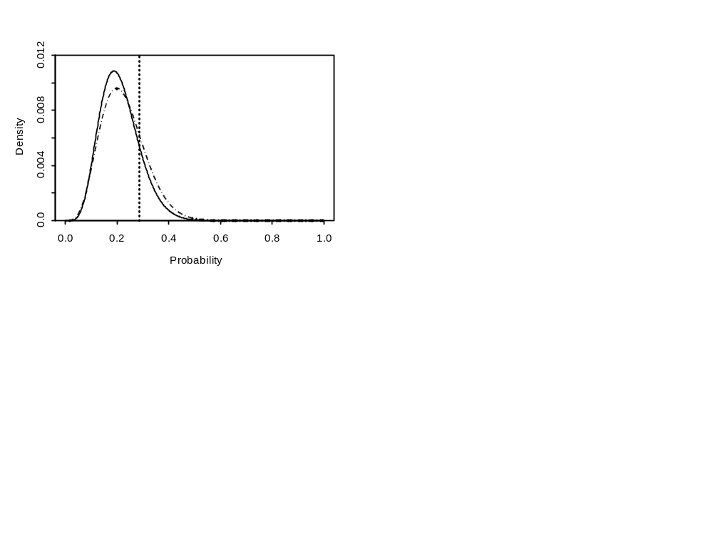
Marginal posterior for θ

Slide 22
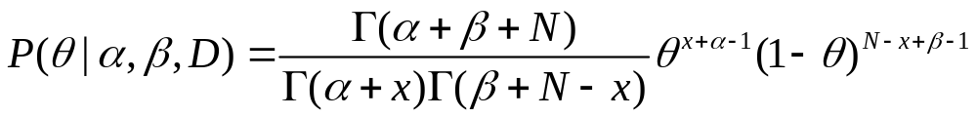
The Unknown Park
To simulate a value of θ for an unknown park, select a value from:
To simulate the data for an unknown park:
  Generate θ as above.
  Given N, select x as a binomial random variable.

Slide 23

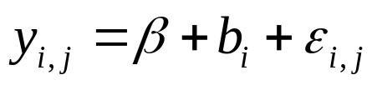
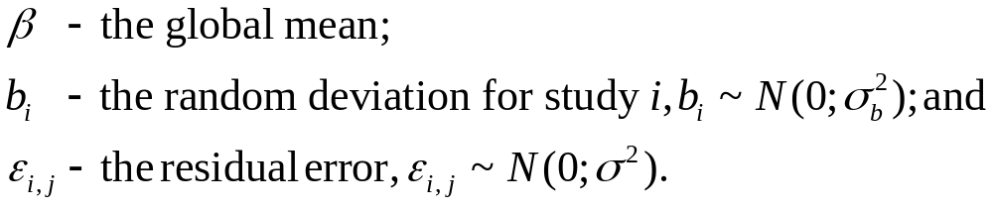
A Simpler Problem-I
Assume that the j^{th} value of a response variable for study i, is:
Priors need to be assigned to β, σ_{b}, and σ to conduct a Bayesian
analysis

Slide 24
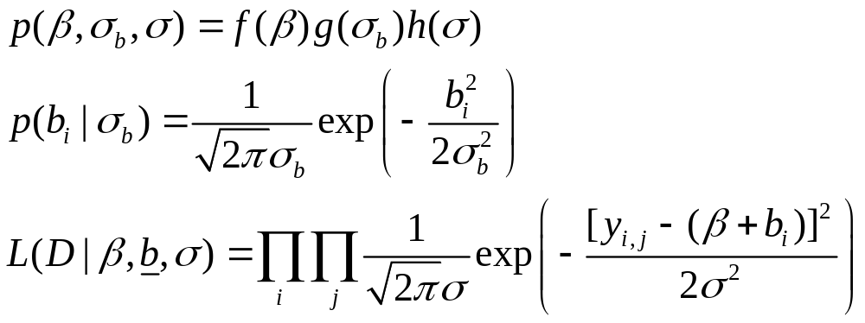
A Simpler Problem-II

Slide 25



Requirements-I
If there are no additional data, one almost always assumes that there is no ordering or grouping of the experiments, i.e. the experiments are exchangable.
The parameters are exchangable if is independent of permutations of the indices .

Slide 26
Requirements-II
In practice, ignorance implies exchangability. The less we know about a problem, the more confident we are about exchangability… (Gelman et al., 1995).
Note that it may be possible to make a set of experiments exchangable if account is taken of appropriate covariates.

Slide 27
The Harsh Reality
For most practical problems (e.g. stock assessment), there are no closed form solutions, so we need to apply numerical methods.
Often the lowest level of the hierarchy can be dealt with analytically (e.g. if the prior is conjugate).

Slide 28
Back to Basics
Consider the problem of finding the posterior distribution for θ in the naïve case.
  Specify α and β (and hence the prior – there is no hyper-prior in this case).
  Generate values for θ from p(θ|α, β).
  Calculate the likelihood of the data for each value of θ.
  Resample values for θ from the set with probability proportional to the likelihood.

Slide 29
Results (Back to basics)-I
The R code:
library(MASS)
xx <- rbeta(100000,1.4,8.6)
yy <- xx^4*(1-xx)^10
xx2 <- sample(xx,10000,replace=T,prob=yy)
truehist(xx2,xlab="Probability")

Slide 30
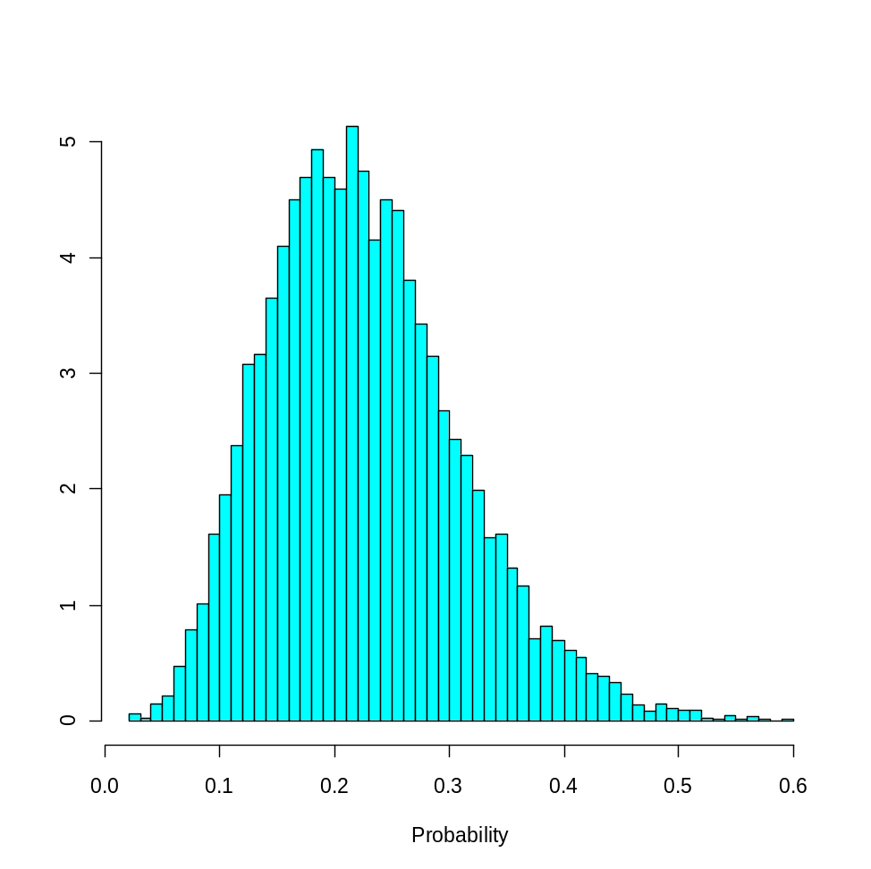
Results (Back to basics)-II
μ=0.226
σ=0.084

Slide 31
A Bayesian Meta-Analysis
(Version 1)
Specify a hyper-prior for α and β.
Generate values for α and β from the hyper-prior.
Generate values for θ_{i}:i=1,2,3,4… from p(θ|α, β).
Calculate the likelihood of the data for the current parameter vector.
Repeat steps 2-4 many times.
Resample parameter vectors from the set generated at steps 2-4 with probability proportional to the likelihood of each.

Slide 32
A Bayesian Meta-Analysis
(Version 1)
The algorithm on the previous slide didn’t work (at all) – 100,000 samples from the prior led to a resample of only 2.
Alternatives:
  use an importance function (but how to choose one); or
  apply MCMC.

Slide 33
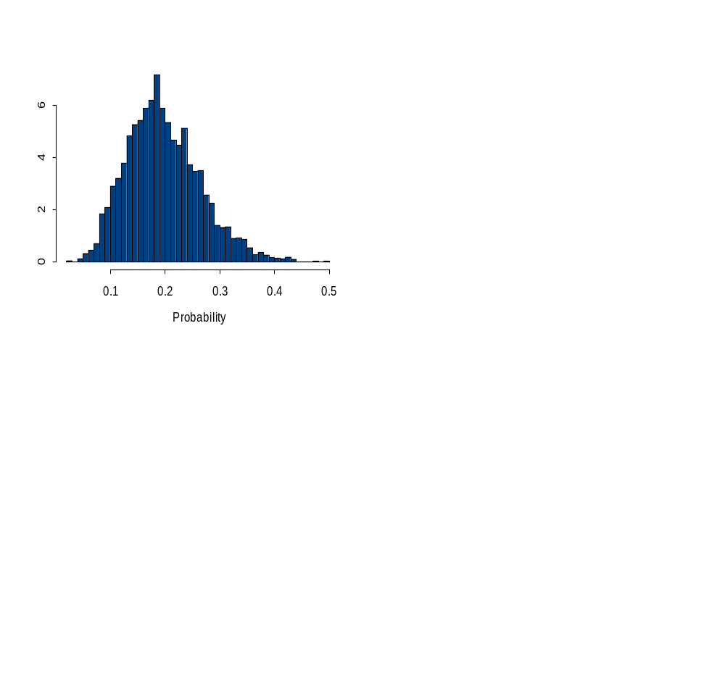
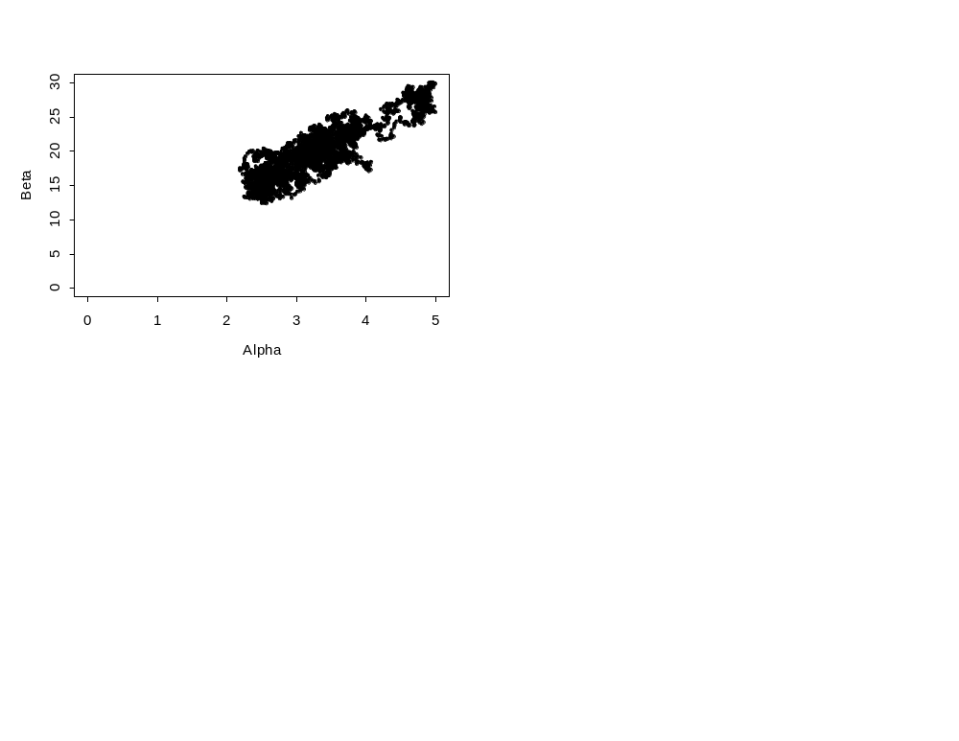
A Bayesian Meta-Analysis
(MCMC Version)
We could improve the
performance of the MCMC
algorithm by transforming the
variables – why?
μ=0.197
σ=0.067
N=1,000,000 cycles; 50% burn-in;
Thinned by a factor of 100.

Slide 34
Extensions / Issues
We assumed that the hyper-prior was a beta distribution. A common alternative is the normal distribution.
Selection of the hyper-prior and its parameterization can be arbitrary and the results of analyses may be sensitive to the choice of the hyper-prior.
In fisheries, the “data” is often output from stock assessments and hence may have a complicated error structure.

Slide 35
Types of inference in meta-analysis
Group-level
  “What is the average effect in general?”
Individual-level
  “What is an estimate for study i that takes into account all information from other studies?”
Predictive
  “What is the best estimate for the next study?”

Slide 36
Six principles of fisheries meta-analysis
Choose appropriate model complexity and sample size.
Use multiple lines of evidence to support a hypothesis or interpretation
Consider alternative hypotheses
Strive for single-stage meta-analysis
Account for experimental, parametric, and functional variability.
Identify the desired type(s) of inference and proceed accordingly

Slide 37
More information
Thorson, J. T., J. Cope, K. Kleisner, A. Shelton, J. Samhouri, and E. Ward. In press. Giants’ shoulders 15 years later: Lessons, challenges, and guidelines in fisheries meta-analysis. Fish and Fisheries.
Hilborn, R., and M. Liermann. 1998. Standing on the shoulders of giants: learning from experience in fisheries. Reviews in Fish Biology and Fisheries 8:273–283.

